Slide 1

AI Workshop
By Muhamad Nur Rohman
Day 6
July 14, 2022

Slide 2
Topics
1. Dataset pre-processing | : | Normalization (input and output) | Day 1
 |  | Randomization (shuffle)
 |  | Dataset division (training, validation, and testing)
 |  | Dataset division using cross validation
2. Variable importance analysis | : | Random forest | Day 1
3. AI-based modeling | : | Support vector machine (SVM/SVR) | Day 2
 |  | Random forest for classification/regression
 |  | ANN/DNN
4. Metaheuristic optimization | : | Particle swarm optimization (PSO) | Day 3
5. Hybrid AI-based model – metaheuristic optimization (Hyperparameter tuning) | : | SVR-PSO ANN-PSO DNN-PSO ANN/DNN fine-tuning | Day 4
6. Optimization using machine learning model | : | PSO-SVR | Day 5
7. Object measurement | : | Computer vision / OpenCV | Day 6

Slide 3
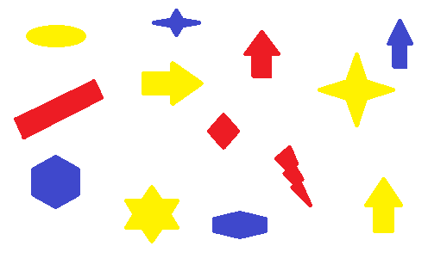
Example
RGB_image.png
We aim to measure the dimension of each object based on their color, namely yellow, red, and blue.

Slide 4
Steps
1
2
Image segmentation based on their color (color space)
Object measurement
Convert the color space from BGR to HSV
Define the range of color in HSV
Threshold the HSV image to get only the intended color
Get the segmented image (yellow, red, and blue).
Convert BGR image to grayscale
Remove the noises using binary threshold
Find the total objects
Measure the dimension of each object:
Find the contour
Find the area of the contour
Find the coordinates
Find the midpoints
Calculate the lengths based on the distance of between two mid points.

Slide 5
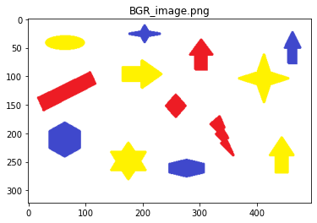
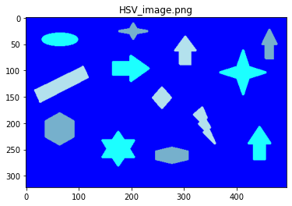
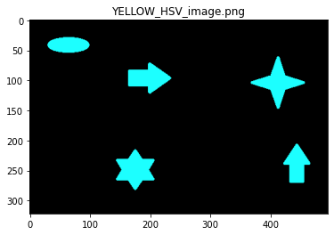
1
Image segmentation based on their color (color space)
Convert the color space from BGR to HSV
Define the range of color in HSV
Threshold the HSV image to get only the intended color
Get the segmented image (yellow, red, and blue).

Slide 6
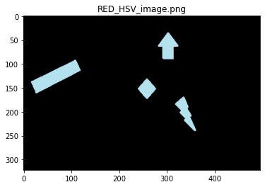
1
Image segmentation based on their color (color space)
Convert the color space from BGR to HSV
Define the range of color in HSV
Threshold the HSV image to get only the intended color
Get the segmented image (yellow, red, and blue).

Slide 7
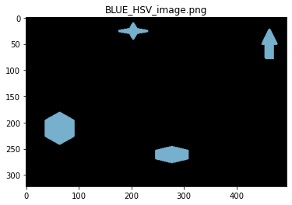
1
Image segmentation based on their color (color space)
Convert the color space from BGR to HSV
Define the range of color in HSV
Threshold the HSV image to get only the intended color
Get the segmented image (yellow, red, and blue).

Slide 8
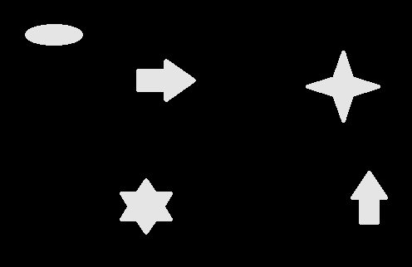
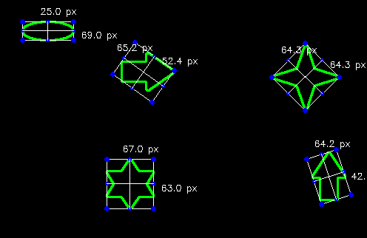
Measurement of yellow colored objects
2
Object measurement
1
2
Convert BGR image to grayscale
Remove the noises using binary threshold
Find the total objects
Measure the dimension of each object:
Find the contour
Find the area of the contour
Find the coordinates
Find the midpoints
Calculate the lengths based on the distance of between two mid points.
 | dA | dB
0 | 67.0 | 63.0
1 | 64.2 | 42.1
2 | 65.2 | 52.4
3 | 64.3 | 64.3
4 | 25.0 | 69.0
3
4

Slide 9
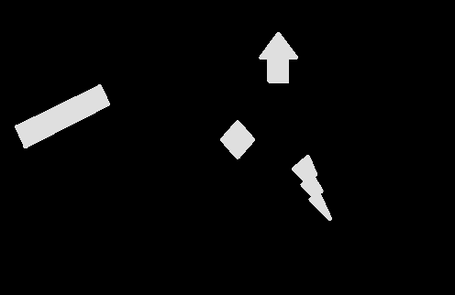

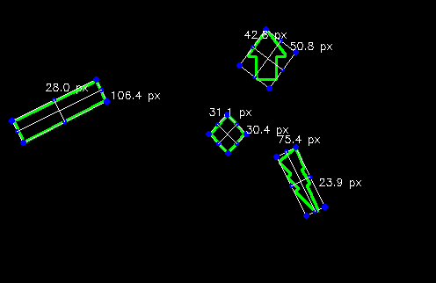
Measurement of red colored objects
2
Object measurement
1
2
Convert BGR image to grayscale
Remove the noises using binary threshold
Find the total objects
Measure the dimension of each object:
Find the contour
Find the area of the contour
Find the coordinates
Find the midpoints
Calculate the lengths based on the distance of between two mid points.
 | dA | dB
0 | 75.4 | 23.9
1 | 31.1 | 30.4
2 | 28.0 | 106.4
3 | 42.8 | 50.8
3
4

Slide 10
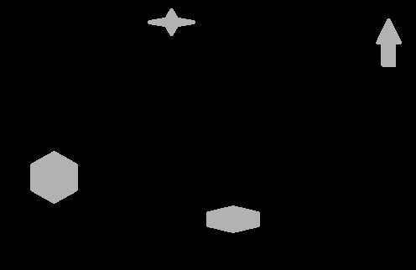

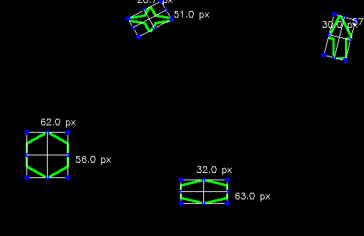
Measurement of blue colored objects
2
Object measurement
1
2
Convert BGR image to grayscale
Remove the noises using binary threshold
Find the total objects
Measure the dimension of each object:
Find the contour
Find the area of the contour
Find the coordinates
Find the midpoints
Calculate the lengths based on the distance of between two mid points.
 | dA | dB
0 | 32.0 | 63.0
1 | 62.0 | 56.0
2 | 30.0 | 57.2
3 | 28.7 | 51.0
3
4

Slide 11
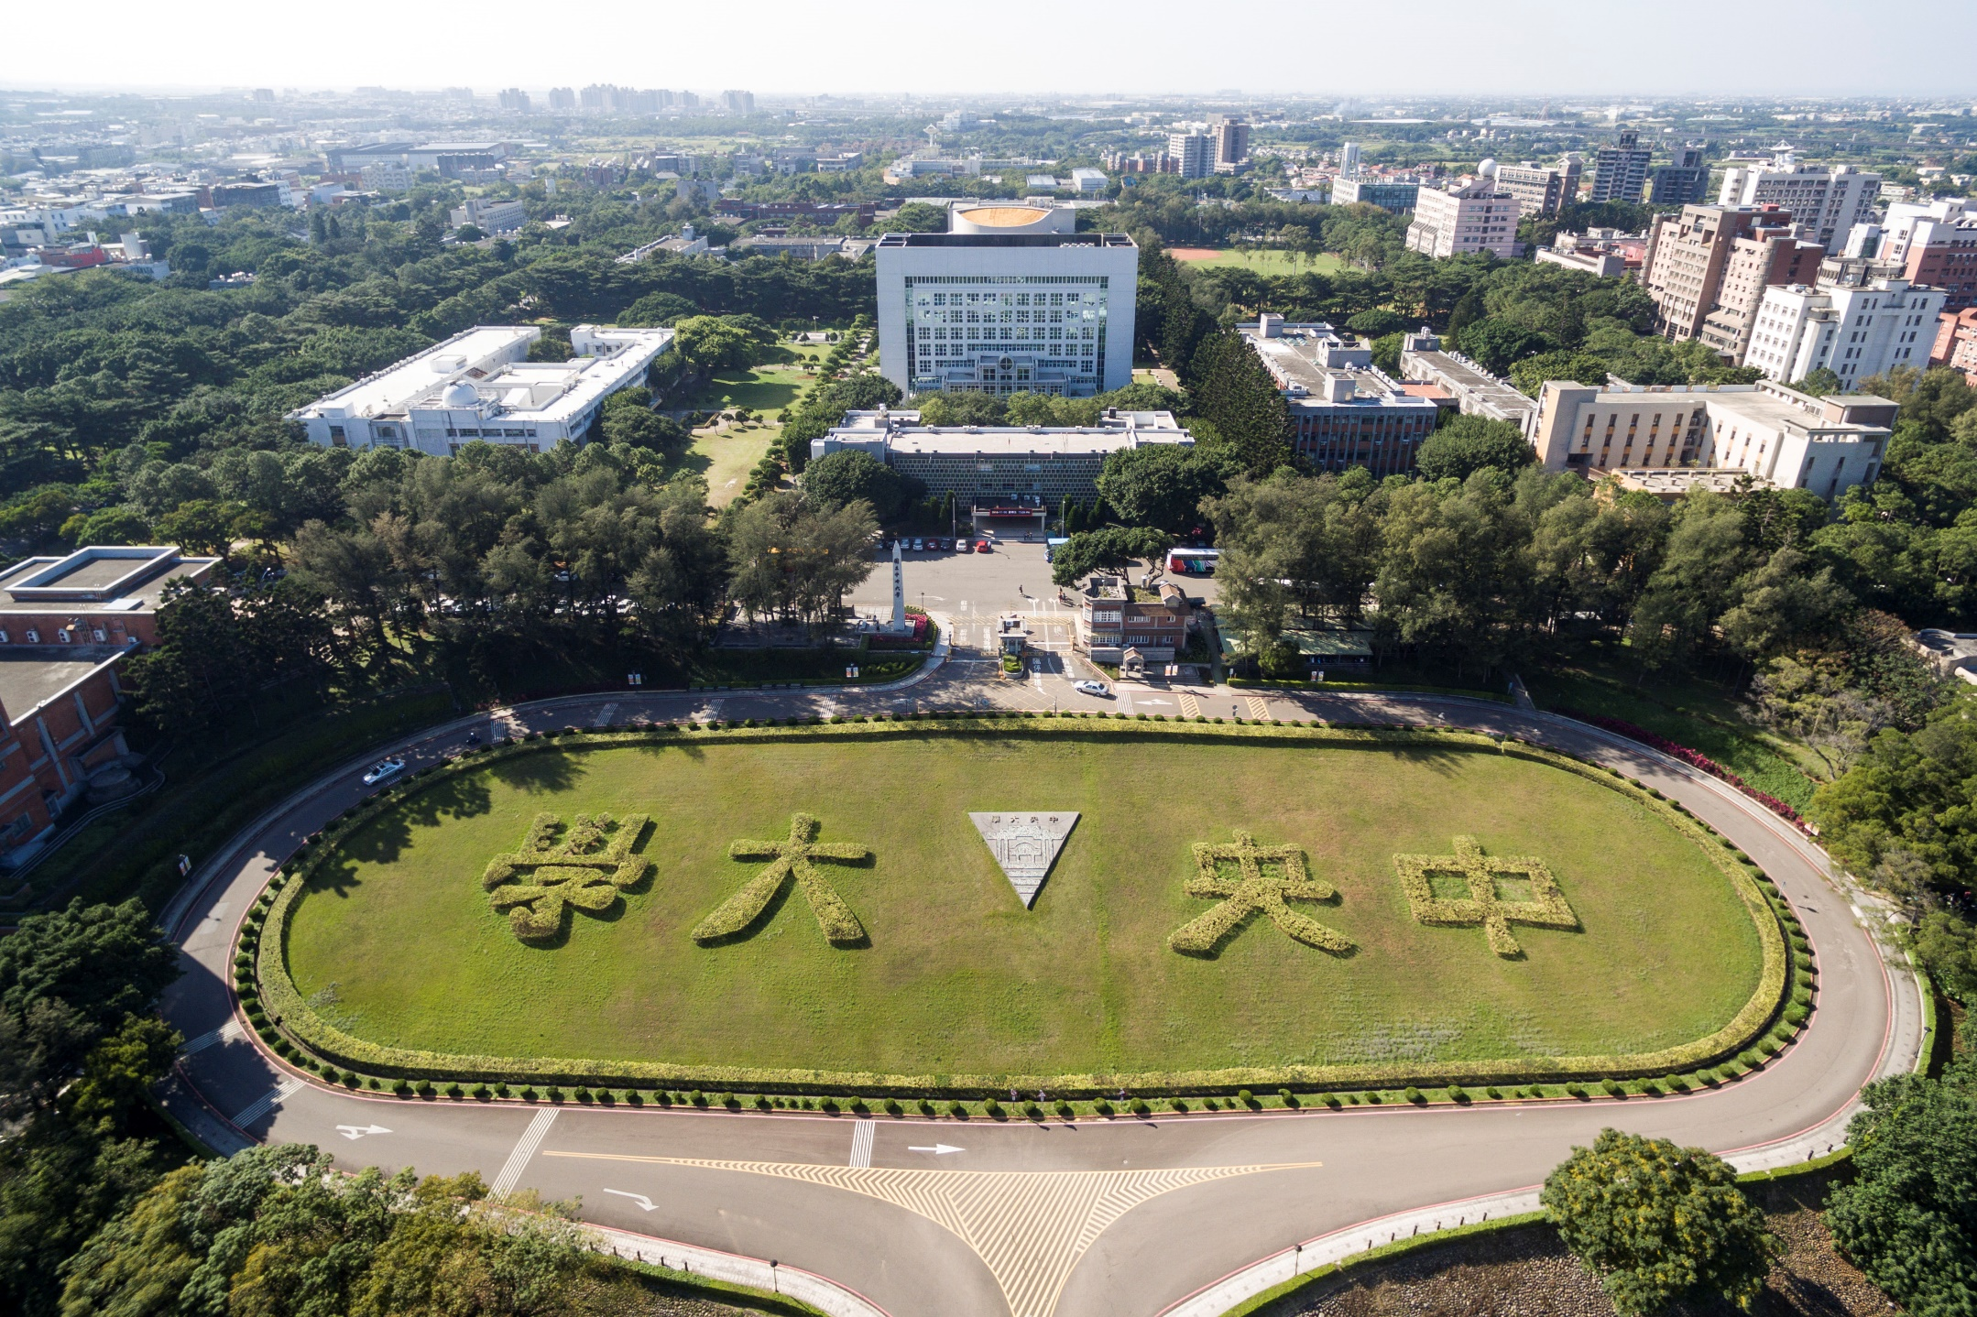
Thank you for your attention

